Slide 1
Lecture 12
The Normal Distribution, z-scores and Transformations

Slide 2
What you should know: kinds of study
Experimental study
Units are assigned to treatments at random: the study creates the groups.
Observational study
Variables are measured on each unit and nothing is assigned.
Survey
Selected units answer questions, to describe a population.

Slide 3
What you should know: sampling designs
Simple random sample (SRS), and systematic sample
SRS: every sample of n is equally likely. Systematic: random start, then every kth unit.
Stratified random sample, and cluster sample
Stratified: an SRS from every stratum. Cluster: randomly chosen whole clusters.
Convenience sample, and voluntary response sample
The easiest to reach, or self-selected. Both are biased at any sample size.

Slide 4
What you should know: experimental designs
Completely randomized design
Every unit is assigned to a treatment completely at random.
Randomized block design
Random assignment is done separately within blocks of similar units.
Matched pairs design
Blocks of two similar units, or one subject who receives both treatments.

Slide 5
What you should know: terminology
The language of an experiment
Units, factor, levels, treatments, control group, placebo, blinding.
Association is not causation
A lurking variable can create an association with no causal link.
The two things randomness buys you
Random sampling lets you generalize. Random assignment lets you claim cause.

Slide 6
Data: female student heights
A survey of 379 college students recorded each student's height and gender; 262 are women.
X = the height of a female student, in inches
HEIGHT | GENDER
56 | Female
57 | Female
58 | Female
60 | Female
60 | Female
… | …
n = 262 women (the file is sorted from shortest to tallest)

Slide 7
Data: Central Park in January
The National Weather Service has recorded the mean temperature in Central Park, New York, every month since 1869.
X = the mean January temperature in Central Park in a given year, in °F
YEAR | JAN | FEB | MAR | … | DEC | ANNUAL
1869 | 35.1 | 34.5 | 34.8 | … | 34.7 | 51.4
1870 | 37.5 | 31.3 | 34.1 | … | 34.1 | 53.6
1871 | 28.3 | 30.2 | 44.2 | … | 29.2 | 51.1
1872 | 28.8 | 29.9 | 30.5 | … | 26.7 | 51
1873 | 28.6 | 29.5 | 35.7 | … | 36.5 | 51
… | … | … | … | … | … | …
n = 150 years, 1869 to 2018

Slide 8
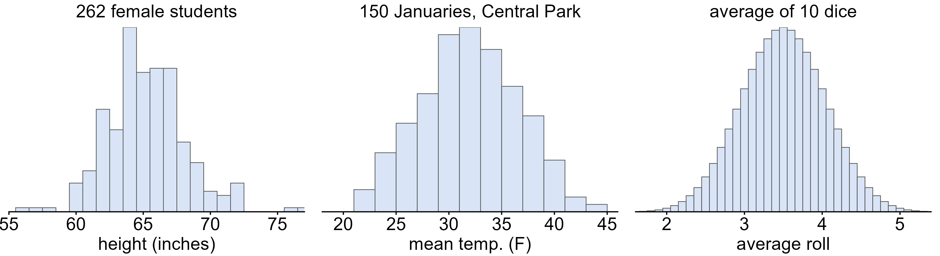
What do these have in common?
What do these three distributions have in common?
Each is single-peaked, symmetric and bell shaped

Slide 9
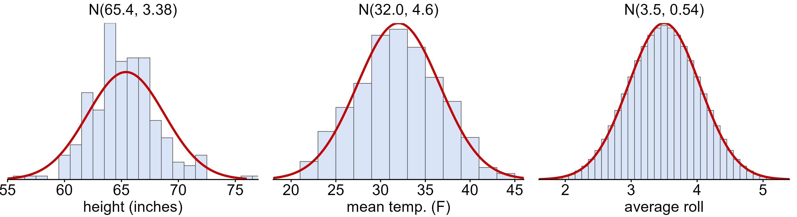
The normal distribution
normal distribution
a symmetric, bell-shaped curve with its peak at the mean

Slide 10
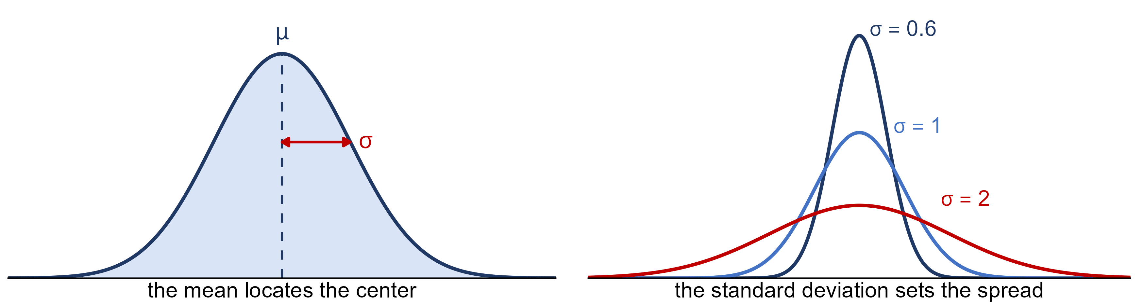
Two parameters: μ and σ
X ~ N(μ, σ)
μ locates the center; σ sets the spread

Slide 11
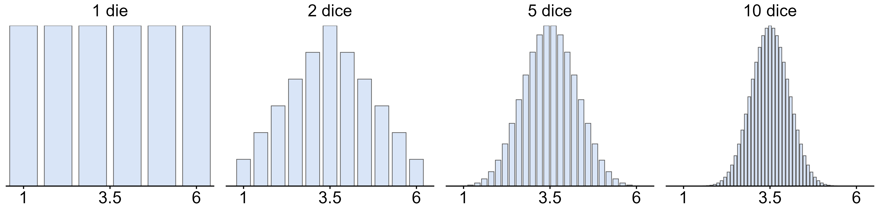
Why is the normal so important?
Why does one curve matter so much?
Many measurements are approximately normal
Averages of random values become normal, whatever the data look like
Most methods in this course are built on it

Slide 12
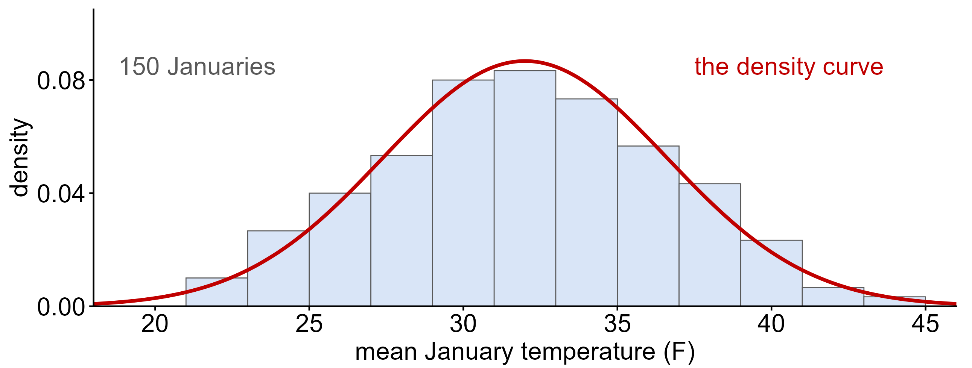
Density curves
density curve
a smooth curve that describes a distribution; the total area under it is 1

Slide 13
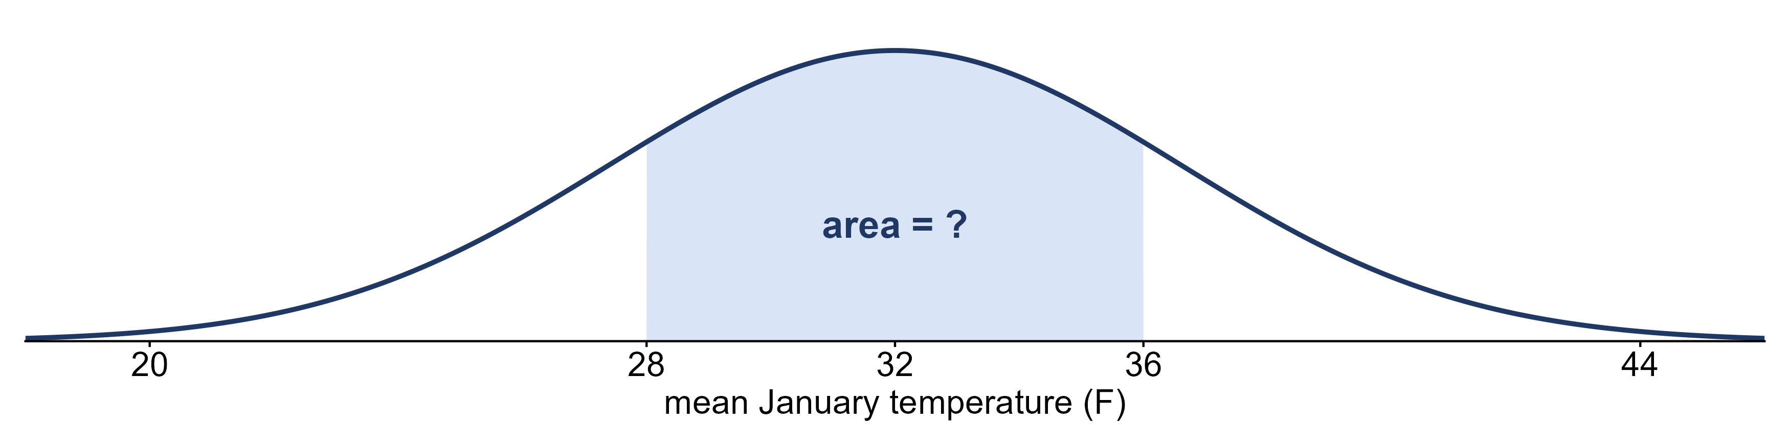
Area under the curve is proportion
Central Park, 150 Januaries: x̄ = 32.0°F s = 4.6°F
What fraction of Januaries averaged between 28°F and 36°F?
Area under the curve: 0.62 Actual: 92 of 150 = 0.61
The height of the curve is density: where values crowd. The area is the proportion.

Slide 14
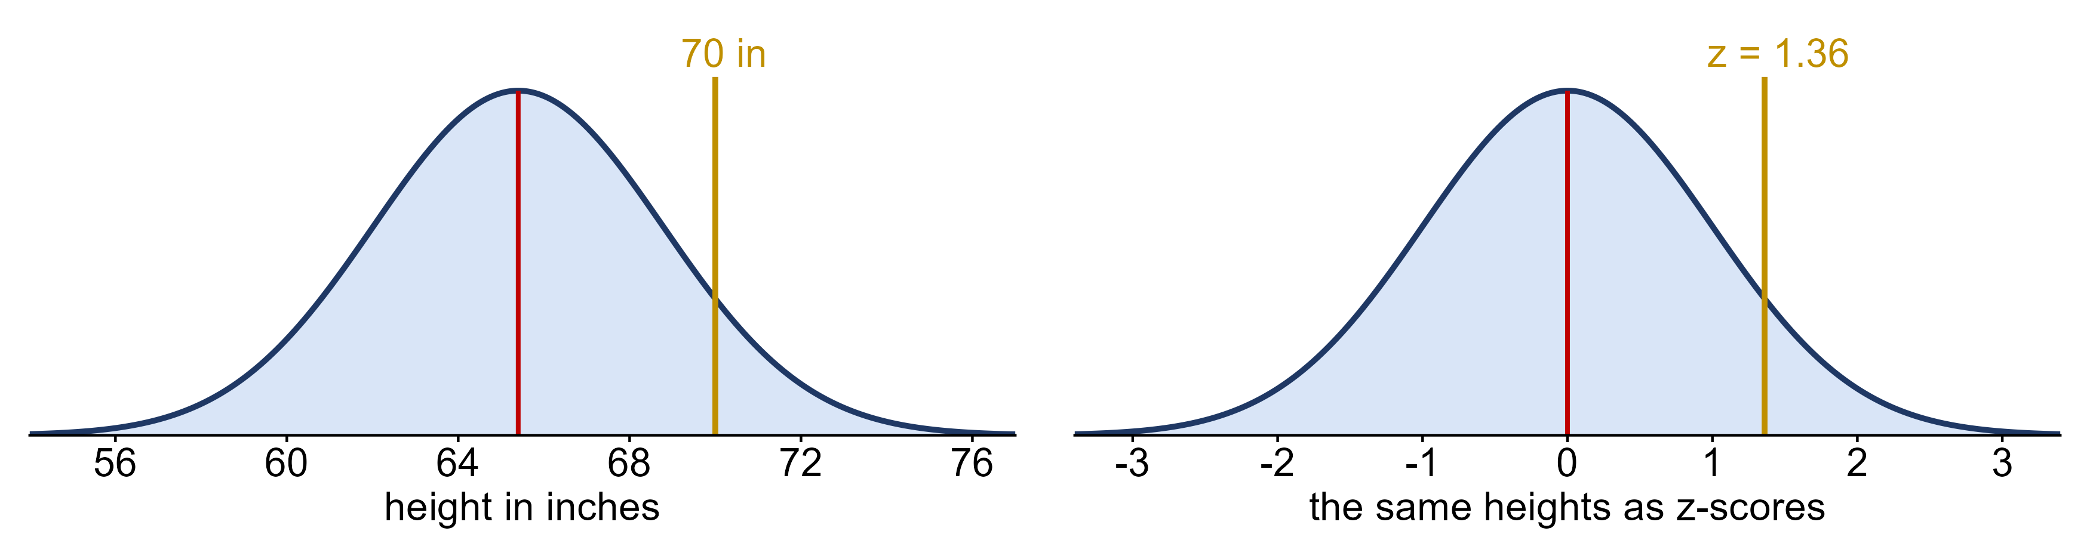
The standard normal distribution
standard normal distribution
the normal distribution with mean 0 and standard deviation 1, written Z ~ N(0, 1)

Slide 15
Data: breakfast cereals
The twenty US breakfast cereals from Week 3, with their sodium and sugar content.
Y = the sodium content of a breakfast cereal, in mg
Cereal | Sodium | Sugar | Type
Frosted Mini Wheats | 0 | 11 | A
Raisin Bran | 340 | 18 | A
All Bran | 70 | 5 | A
Apple Jacks | 140 | 14 | C
Captain Crunch | 200 | 12 | C
… | … | … | …
n = 20 cereals

Slide 16
Which observation is more extreme?
X = an exam score (points) and Y = the sodium in a breakfast cereal (mg); each sample has n = 20.
Sample 1 (X): x̄ = 74, s = 8, observation x = 90
Sample 2 (Y): ȳ = 167, s = 77, observation y = 290
Which observation is more extreme?
x = 90: 16 / 8 = 2.0 standard deviations above its mean
y = 290: 123 / 77 ≈ 1.6 standard deviations above its mean
x = 90 is more extreme

Slide 17
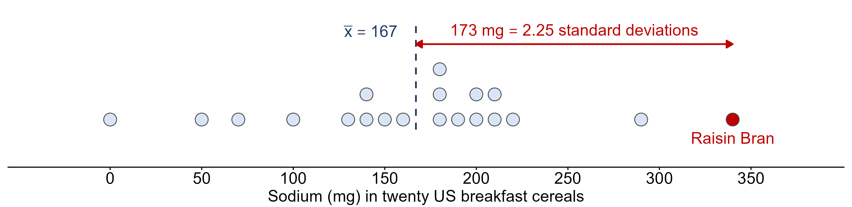
Measuring a deviation in standard deviations
How unusual is the sodium in Raisin Bran, among the 20 cereals from Week 3?
x = 340 mg x̄ = 167 mg s = 77 mg
z = (x − x̄) / s = 173 / 77 = 2.25 → the z-score

Slide 18
Example: Jerome's points
Jerome averages 16 points a game, and one night he scores 10 (textbook Try It 6.2).
X ~ N(16, 4) x = 10
x = 10 is ____ standard deviations to the ____ (right or left) of the mean ____.
z = (10 − 16) / 4 = −1.5
1.5 standard deviations to the left of the mean, 16

Slide 19
Data: EU carbon emissions
The World Bank's carbon dioxide emissions per person for the 28 member states of the European Union.
X = the carbon dioxide emissions per person in an EU country, in metric tons
Country Name | Country Code | CO2
Austria | AUT | 8
Belgium | BEL | 10
Bulgaria | BGR | 6
Croatia | HRV | 4.7
Cyprus | CYP | 7
… | … | …
n = 28 countries

Slide 20
Example: carbon emissions across the EU
Carbon emissions per person in the 28 EU member states (World Bank).
x̄ = 7.9 t s = 3.6 t Luxembourg = 21.4 t
(a) How many standard deviations above the mean is Luxembourg?
(b) What emission level sits 2 standard deviations above the mean?
(a) z = 3.75
(b) 15.1 t, and only Luxembourg is above it

Slide 21
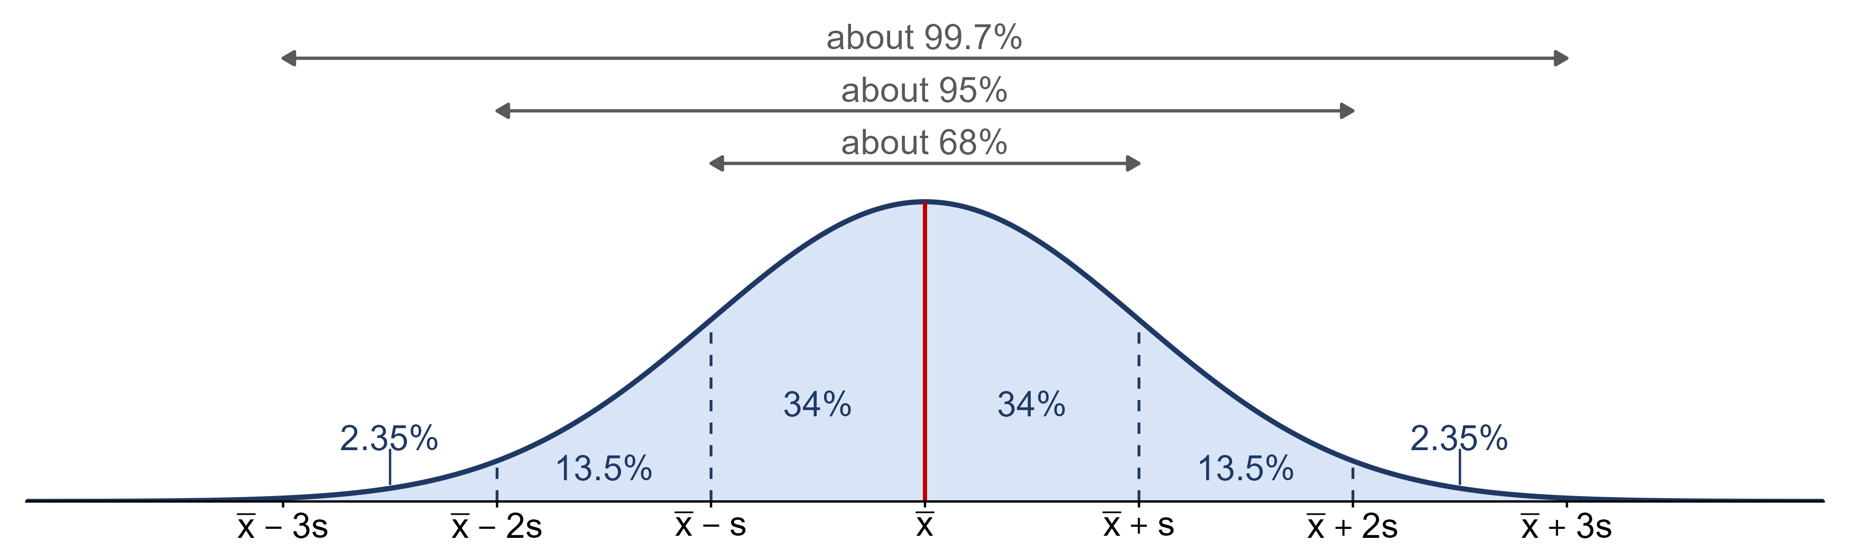
The empirical rule
empirical rule
about 68% of values fall within 1 standard deviation of the mean, 95% within 2, and 99.7% within 3

